Slide 1
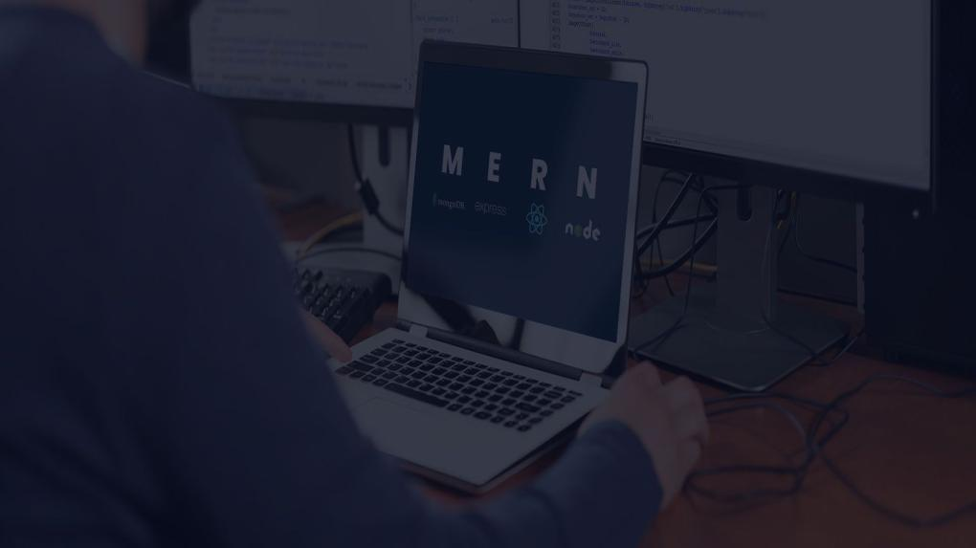
HOSPITAL Management System​ USING MERN STACK
Name: B Sahithya
Reg No: 20MIC0007
Date: 16/04/2025

Slide 2
Overview
Introduction
Gaps identified
Objectives
Problem Statement
Hardware Requirements
Software Requirements
Proposed Architecture
Methodology Adapted
Output Screenshots
Results and Discussion
Conclusion and Future Work
Reference Links

Slide 3
INTRODUCTION
A Hospital Management System (HMS) is a comprehensive software solution designed to streamline and automate various administrative, clinical, and financial processes within a healthcare facility.
It incorporates a number of healthcare administration functions, such as prescription management, medical inventory management, doctor scheduling, and patient visits.
By digitizing and automating administrative and clinical tasks, an HMS improves the efficiency, accuracy, and quality of healthcare services.

Slide 4
INTRODUCTION...
This HMS is built using the MERN stack—a combination of MongoDB, Express.js, React, and Node.js. Every element in the stack is essential to creating a cutting-edge, adaptable, and data-driven hospital management system.
The MERN stack is widely used for developing full-stack web applications due to its flexibility, scalability, and efficiency.
Each component of the stack plays a crucial role in building a modern, responsive, and data-driven hospital management solution

Slide 5
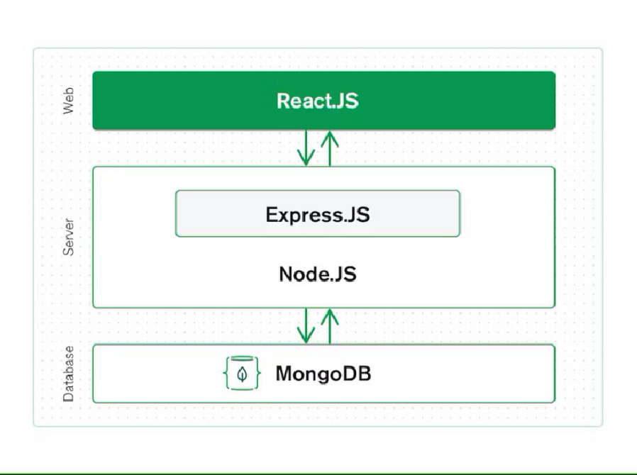
Working of MERN Stack

Slide 6
GAPS IDENTIFIED
The application of this paper is available only on iOS which has locked out many non-Apple users [2].
There is no mention of doctor assigning prescription and medicines to the patient. Inventory and prescription are not handled by the admin [3].
The Mobile Application has logins for different profiles but does not support CRUD operations. [5].
All the papers did not clearly explain about admin functionalities in the website. For example, Admin should be able to add users of all types using add user button – doctor, and patient. The role of each user is not mentioned in the total users’ page.

Slide 7
OBJECTIVES
To integrate the MERN stack to enable scalability and flexibility, making it simple to integrate new features and expand the system in the future.
To increase efficiency in administration by providing resources for tracking inventory, scheduling appointments, checking doctor availability, and creating hospital reports.
To improve patient care by providing a simple user friendly interface to the patients to schedule appointments, read prescriptions, and access medical data.
To enable real-time data access for doctors, admins, and patients, ensuring fast access to the website.

Slide 8
PROBLEM STATEMENT
Manual inefficiencies that the hospitals routinely adopt to handle appointments, medications, and inventories result in errors, delay time, and hindrances to business. Hospital management is busy doing manual tracking of inventory and schedules of physicians and hence doesn't utilize resources properly. These problems adversely affect the quality of patient care and operational efficiency. Thus, there is a requirement for an automated, centralized, and user-friendly system to solve these problems. Thus, to operate hospitals efficiently is a feature-rich, web-based Hospital Management System (HMS) based on cutting-edge software technologies like MERN Stack, which help in automating hospital's key functions, makes working more efficient, ensures better and secure patient care, and scalability.

Slide 9
HARDWARE REQUIREMENTS
OS - Windows/ Linux
Execute instructions - Central processing unit (CPU)
Displaying images - Graphics Processing unit (GPU)
High storage capacity - Hard Disk Drives (HDD)
Temporary Storage - Random Access memory (RAM)
Device - Laptop/ Computer
Processor - Intel Core i5

Slide 10
SOFTWARE REQUIREMENTS
FrontEnd - React.js, Bootstrap, CSS
BackEnd - Node.js, Express.js
Database - MongoDB atlas
Source Code editor- Visual Studio Code
Local Host Browser - Firefox
Windows Version - Windows 10 version and above
Repository - GitHub

Slide 11
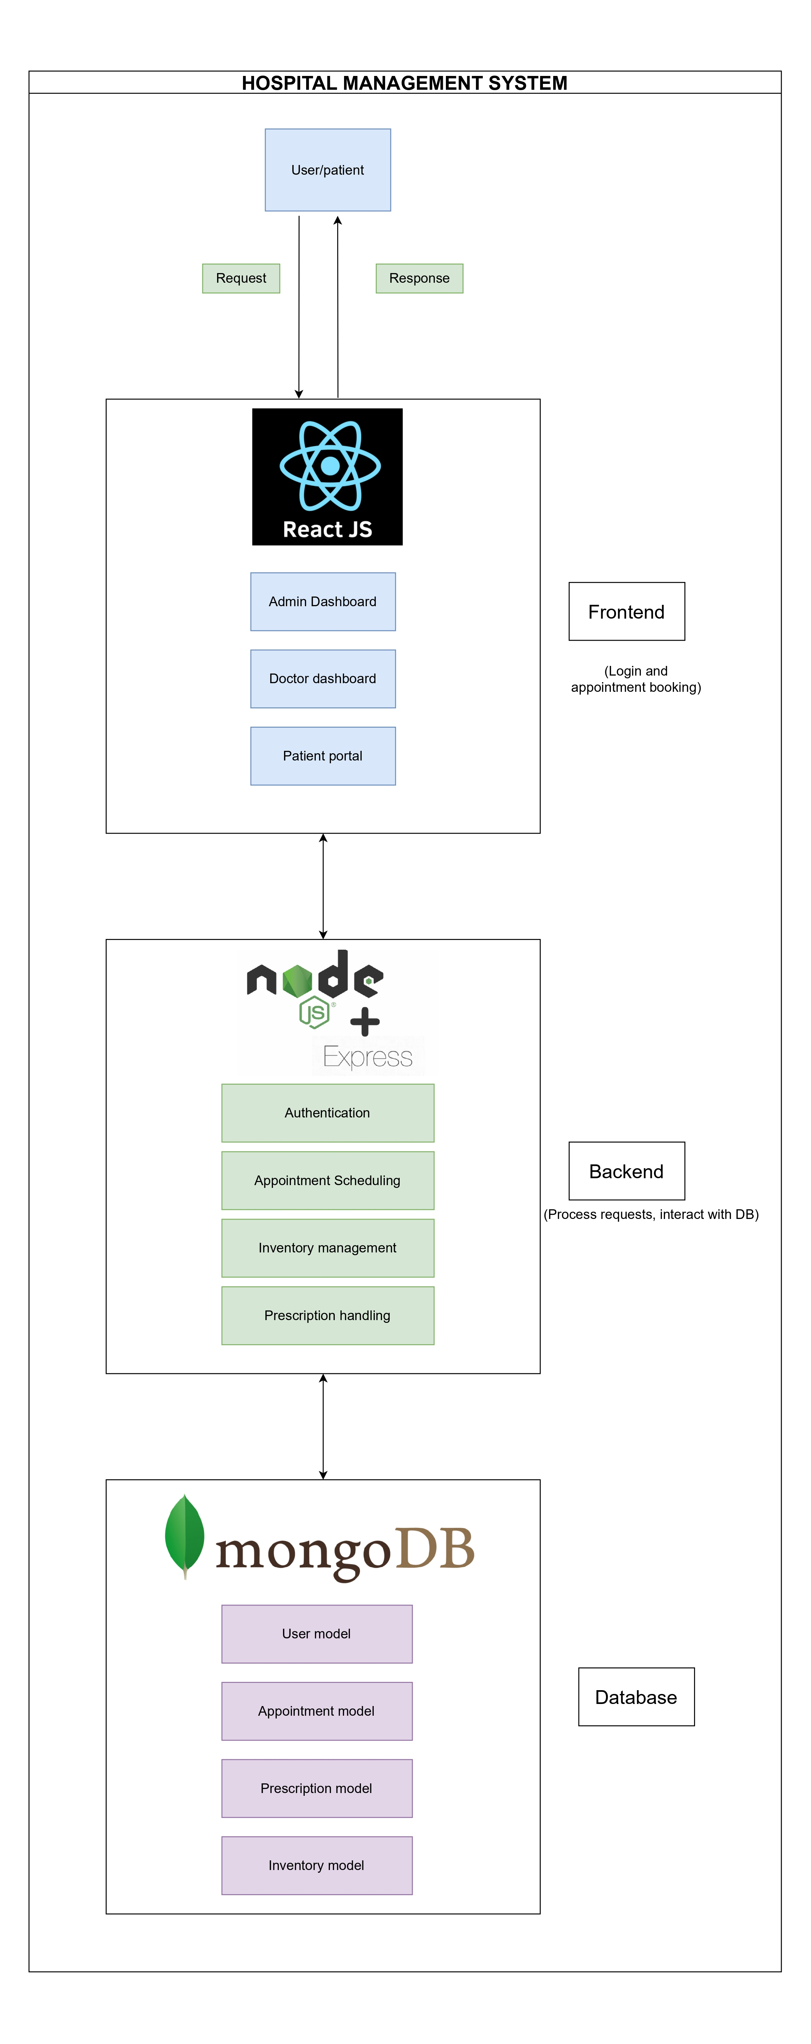
PROPOSED ARCHITECTURE

Slide 12
METHODOLOGY ADAPTED
1. Front End - React JS, CSS and Bootstrap:
This project has a user friendly interface for different profiles. There are 3 different logins – Admin, Doctor and Patient.
To install react project, run the command “npx create-react-app .” in the VS code. After the node modules are installed and we are ready to perform frontend logic.
I developed user-friendly dashboards, appointment booking forms, prescription management interfaces, and user account management pages. The other packages required can be installed accordingly by “npm install”.

Slide 13
METHODOLOGY ADAPTED...
2. Back End – Node JS, Express JS:
Node JS is installed in the VS Code by using npm install or directly installing latest version from the Google. Express JS is a Node JS framework used to build the application offering middleware, routing, etc. The backend is divided into 4 parts mainly - Controllers, models, middlewares, and routes.
Controllers have the main backend logic of the application. It manages request responses. Middlewares controls the authentication purposes, such as to authenticate the users of application and also the requests coming.

Slide 14
METHODOLOGY ADAPTED...
Models has their own backend logics like doctor’s profile, admin’s profile etc. Routes establishes the communication between backend and frontend by having the endpoints if the frontend pages.
3. Database – MongoDB, Mongoose:
Mongo DB ensures to store the user credentials and their information. Mongoose helps to simplify the interaction with the database. Installation is done by “npm install mongoose” command. Create a project in MongoDB atlas to establish connection for the website.

Slide 15
METHODOLOGY ADAPTED...
4. Dotenv:
It is a module that enables the use of environment variables in a Node.js application. Dotenv is used to manage all our sensitive configuration variables, such as database connection strings, API keys, port number and secret tokens.
5. Axios:
Axios is a node package which is used to fetch the doctor prescription, appointments, and their respective information from the database. And axios is also used in user authentication.

Slide 16
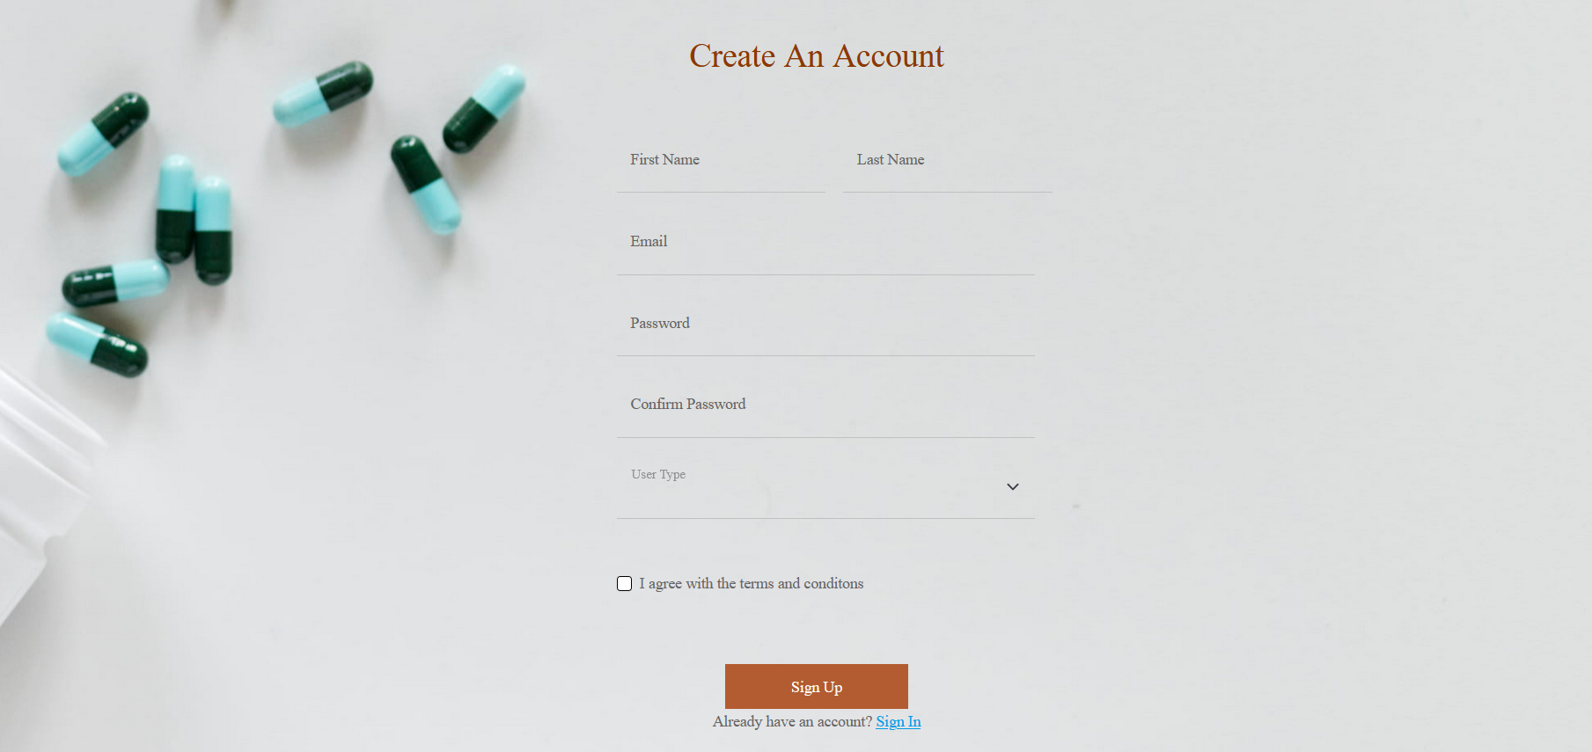
OUTPUT SCREENSHOTS
Sign Up Page

Slide 17
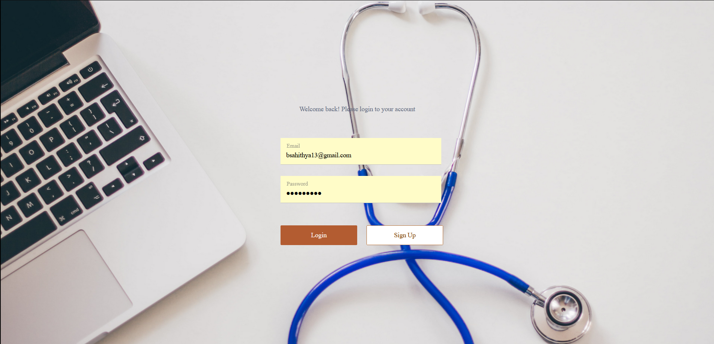
OUTPUT SCREENSHOTS...
Login Page

Slide 18
RESULTS AND DISCUSSION
In this project, I have created an appointment booking system which helps patients to login to the website and book the doctor appointment and get the prescription given by the doctor. The results of this project include:
All the users – doctors, admins, and patients have a different dashboard respectively based on the permissions and each has different benefits.
A sign up page is created for new user. After a successful registration, user is ready to login to the website.
After successful authentication, user can view the available doctors and their schedule. Users can select the doctor and book the appointment.

Slide 19
RESULTS AND DISCUSSION...
Patient’s dashboard has the facility to check the schedule and available slots of the doctor to schedule an appointment.
Admins can add, update and delete the user details which provide the authority of performing CRUD operation to the website.
User profile is categorized as 3 profiles – Admin, Doctor and patient. Admin is the one who operate the prescriptions, inventory, and manage user details. Doctor can select their free time to check the patient and add the prescription. Patient can book the appointment and view the prescription.

Slide 20
CONCLUSION AND FUTURE WORK
The Hospital Management System implemented with the MERN stack effectively solves major issues such as appointment scheduling, patient record management, prescription management, and medicine inventory management. Automating repetitive tasks and providing role-based access, the system improves the efficiency, accuracy, and accessibility of healthcare facilities. It offers an easy-to-use interface for admins, doctors, and patients, making the experience smooth across all modules. The system helps in improved organization of data, less administrative burden, and enhanced patient care through prompt access to medical information.

Slide 21
CONCLUSION AND FUTURE WORK...
Future Work
Developing an online payment module for appointment scheduling and inventory. Creating laboratory page in the future and to install a module for the patient to schedule for lab tests and produce reports and consult doctor. Developing an app for android and iOS to make the application more accessible so that individuals can use it conveniently in a vast array of various people. And lastly, to include regional languages such that users who cannot read English also be able to use the application.

Slide 22
REFERENCE LINKS
Github Repository Link
https://github.com/Sahithya132002/Final-Year-Project

Slide 23
THANK YOU

